Slide 1

GENAI HACKTHON 2025
PayGuard AI
Project Title : PAYGUARD AI
Tagline : your AI power shield against digital payment scams
Theme: Cybersecurity & Artificial Intelligence
Project type : web application
Participant name : Sheetal pal
Team type : Solo project
College : BBD ITM
Date: [Submission date]

Slide 2
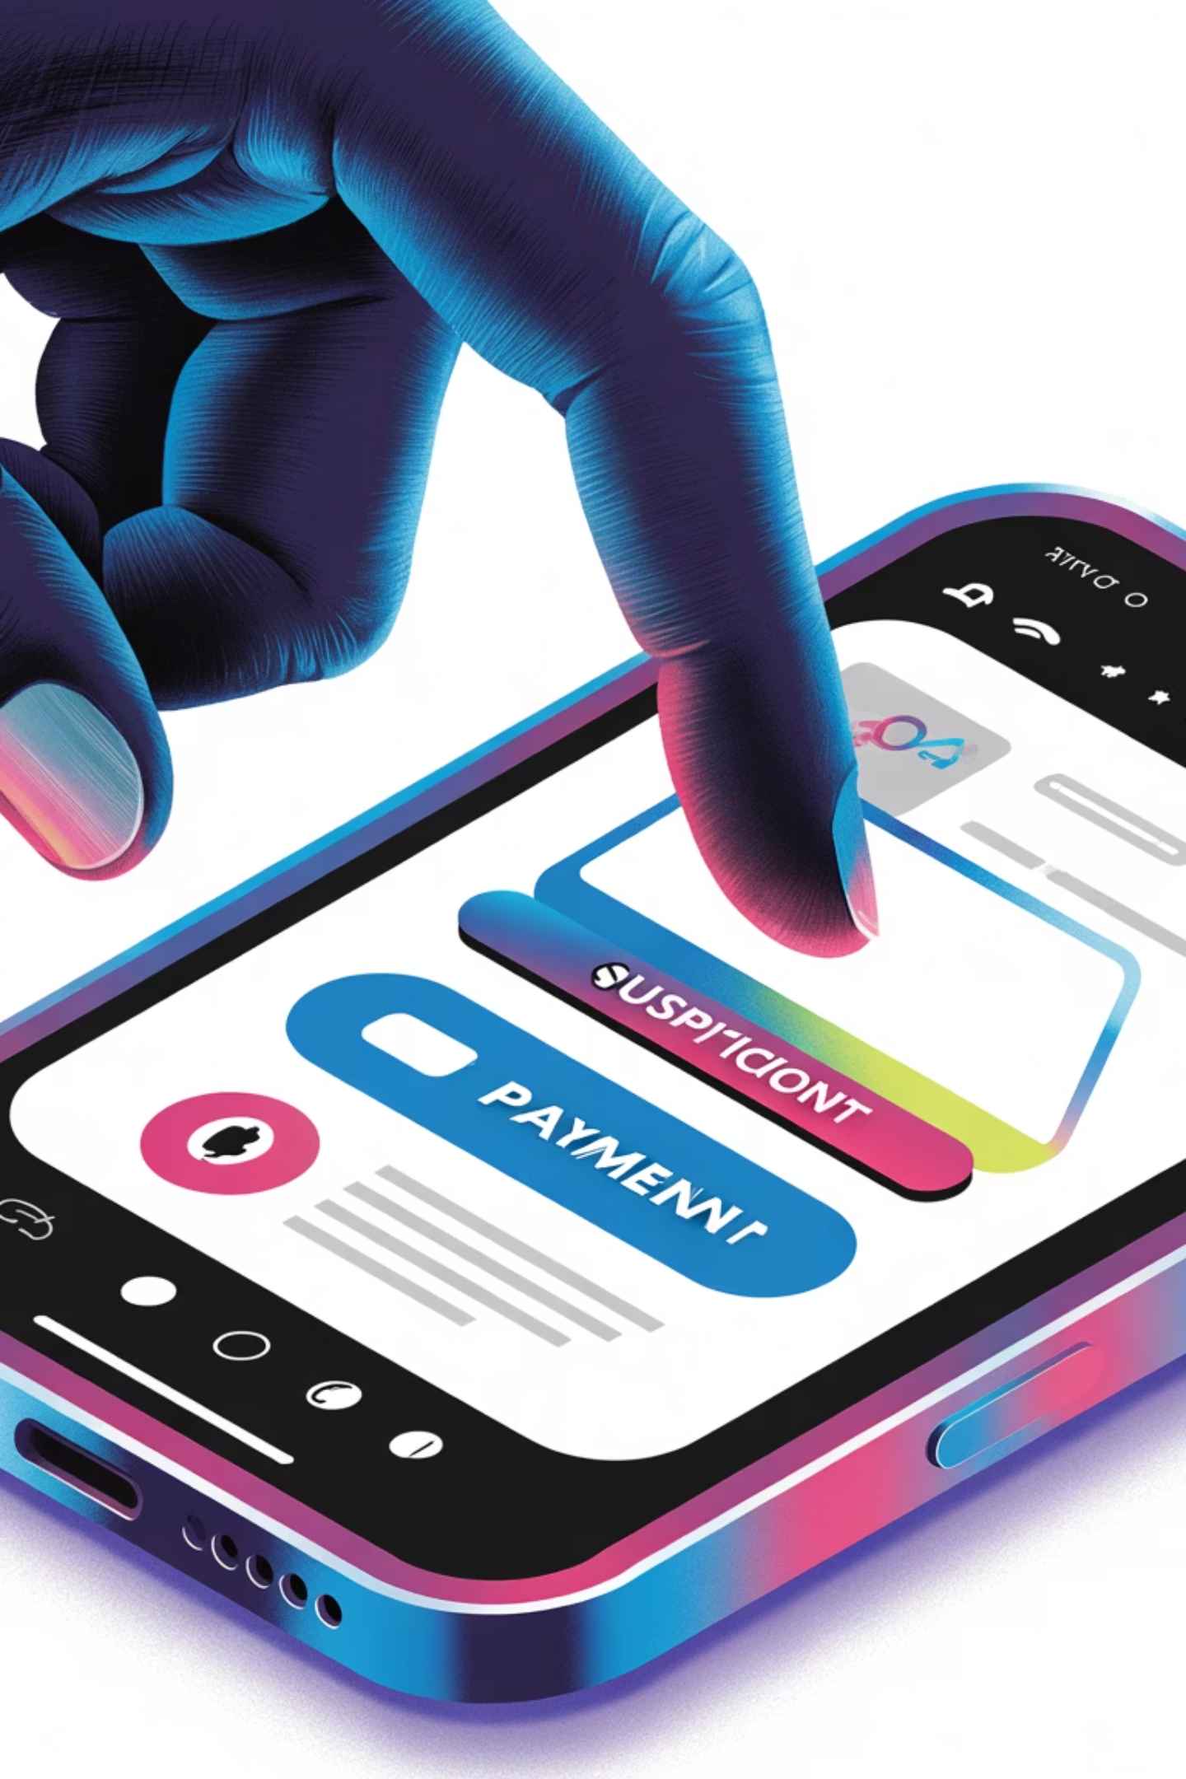

Problem statement
DIGITAL PAYMENT SCAMS ARE INCREASING THROUGH
REAL WORLD PROBLEM
THE NEED
Users often scan fake QR codes in shops or public places.
People click phishing payment links shared via SMS, WhatsApp, or email.
Some messages pretend to be from banks or payment apps, asking for verification or payment details.
There is no simple way for a normal user to know whether a QR code or link is safe or dangerous.
Users require a smart and secure solution that can:
Detect suspicious QR codes, links, or messages in real time.
Warn users before they lose money.
Work as a digital shield for safe online transactions.
THE ISSUE
In the present digital era, people make payments daily using QR codes, payment links, or messages. However, many of these sources are fake or fraudulent, designed to steal money or personal data.

Slide 3




OBJECTIVE AND SOLUTION
To build an AI-powered web application that protects users from digital payment frauds such as fake QR codes, phishing links, and fraudulent messages. Our goal is to make online transactions safer and more trusted for everyone, especially students and common users who use UPI or payment apps daily.
*SOLUTION:
* OBJECTIVE:
PayGuard AI acts as a digital security shield for users. It allows users to scan QR codes or paste payment links/messages, and the AI system instantly:
Analyzes the data using machine learning models.
Detects suspicious patterns or scam behavior.
Warns users with a “Safe” or “Unsafe” status before they proceed with the payment.
Provides a short reason for the risk, helping users make safer choices.
Input
AI Detection
Result & Alert
User submits suspicious text, link, or QR code.
Gemini API analyzes patterns, domain reputation, and embedded scripts.
Instant risk score and critical warning delivered to the user.
PayGuard AI provides an immediate layer of defense, giving users the clarity needed to avoid transferring funds to malicious actors.

Slide 4
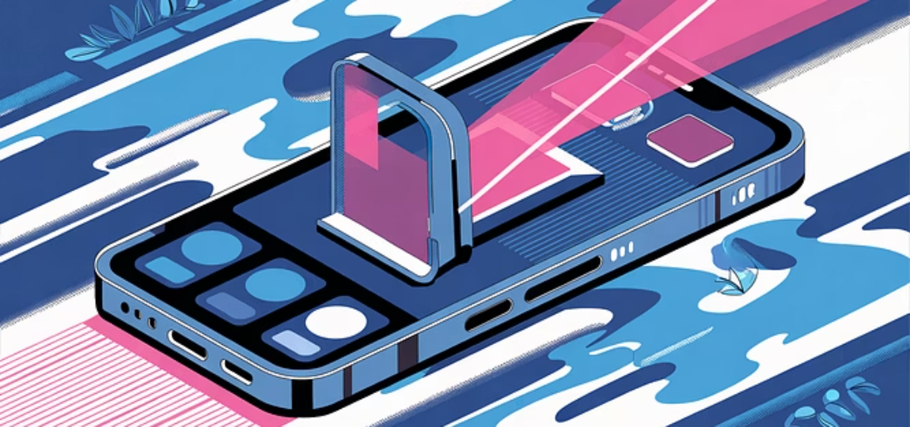

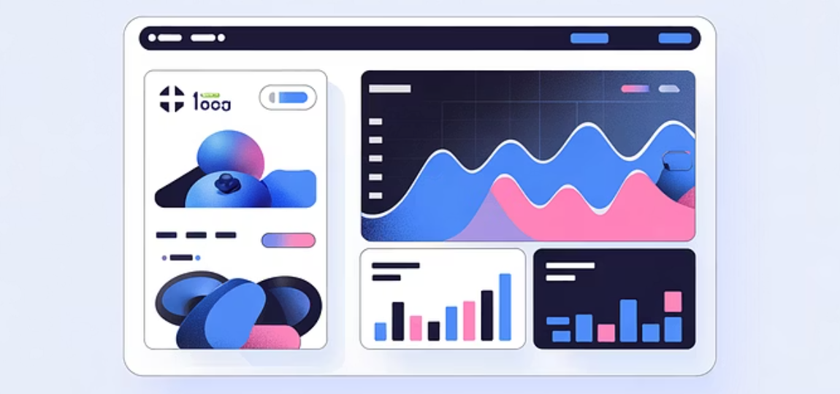






KEY FEATURES
Core Features of PayGuard AI
Smart Link/Text Scanner
QR Code Fraud Detection
NLP models parse incoming messages to identify common phishing and deepfake linguistic patterns.
Analyzes embedded URLs within QR codes against known malware and phishing domain lists.
Real-Time Risk Score
Community Report Database
Presents an immediate, quantifiable assessment of the threat level for every scan or link analyzed.
A user-contributed database of verified scams to rapidly train the model and protect others.

Slide 5

Techstack & Architecture
Technical Architecture & Stack
Analysis Result
User Input
Layer | Technology
Frontend | React/HTML /CSS
Backend | Python Flask / Node .js
AIModel | Gemini API / NLP
Database | Firebase / MongoDB
QRscanner | jsQR / qrcode.js
User-submitted
report or text
Response
returned to user
Scam Report
Database
Frontend
PayGuard Data Flow
React mobile-first UI
Store reports &
metadata
Gemini AI Model
Backend / API Gateway
Rapid scam analysis
Routing auth, rate limiting
Backend / API Gateway
Gemini AI Model
Rapid scam analysis
Routing, auth, rate limiting

Slide 6





Impact & future scope
Future Scope & Expansion
Voice Scam Detection
Societal Impact & Future Vision
Browser Extension Alerts
Immediate Impact
Official UPI API Integration
Financial Loss Reduction
Directly prevents fraudulent transactions, minimizing financial losses for vulnerable users.
Increased Digital Trust
By making payments safer, PayGuard AI encourages wider adoption of digital banking systems.
AI-Driven Cyber Safety
Pioneers the use of sophisticated AI/LLMs as frontline consumer cyber defense tools.

Slide 7
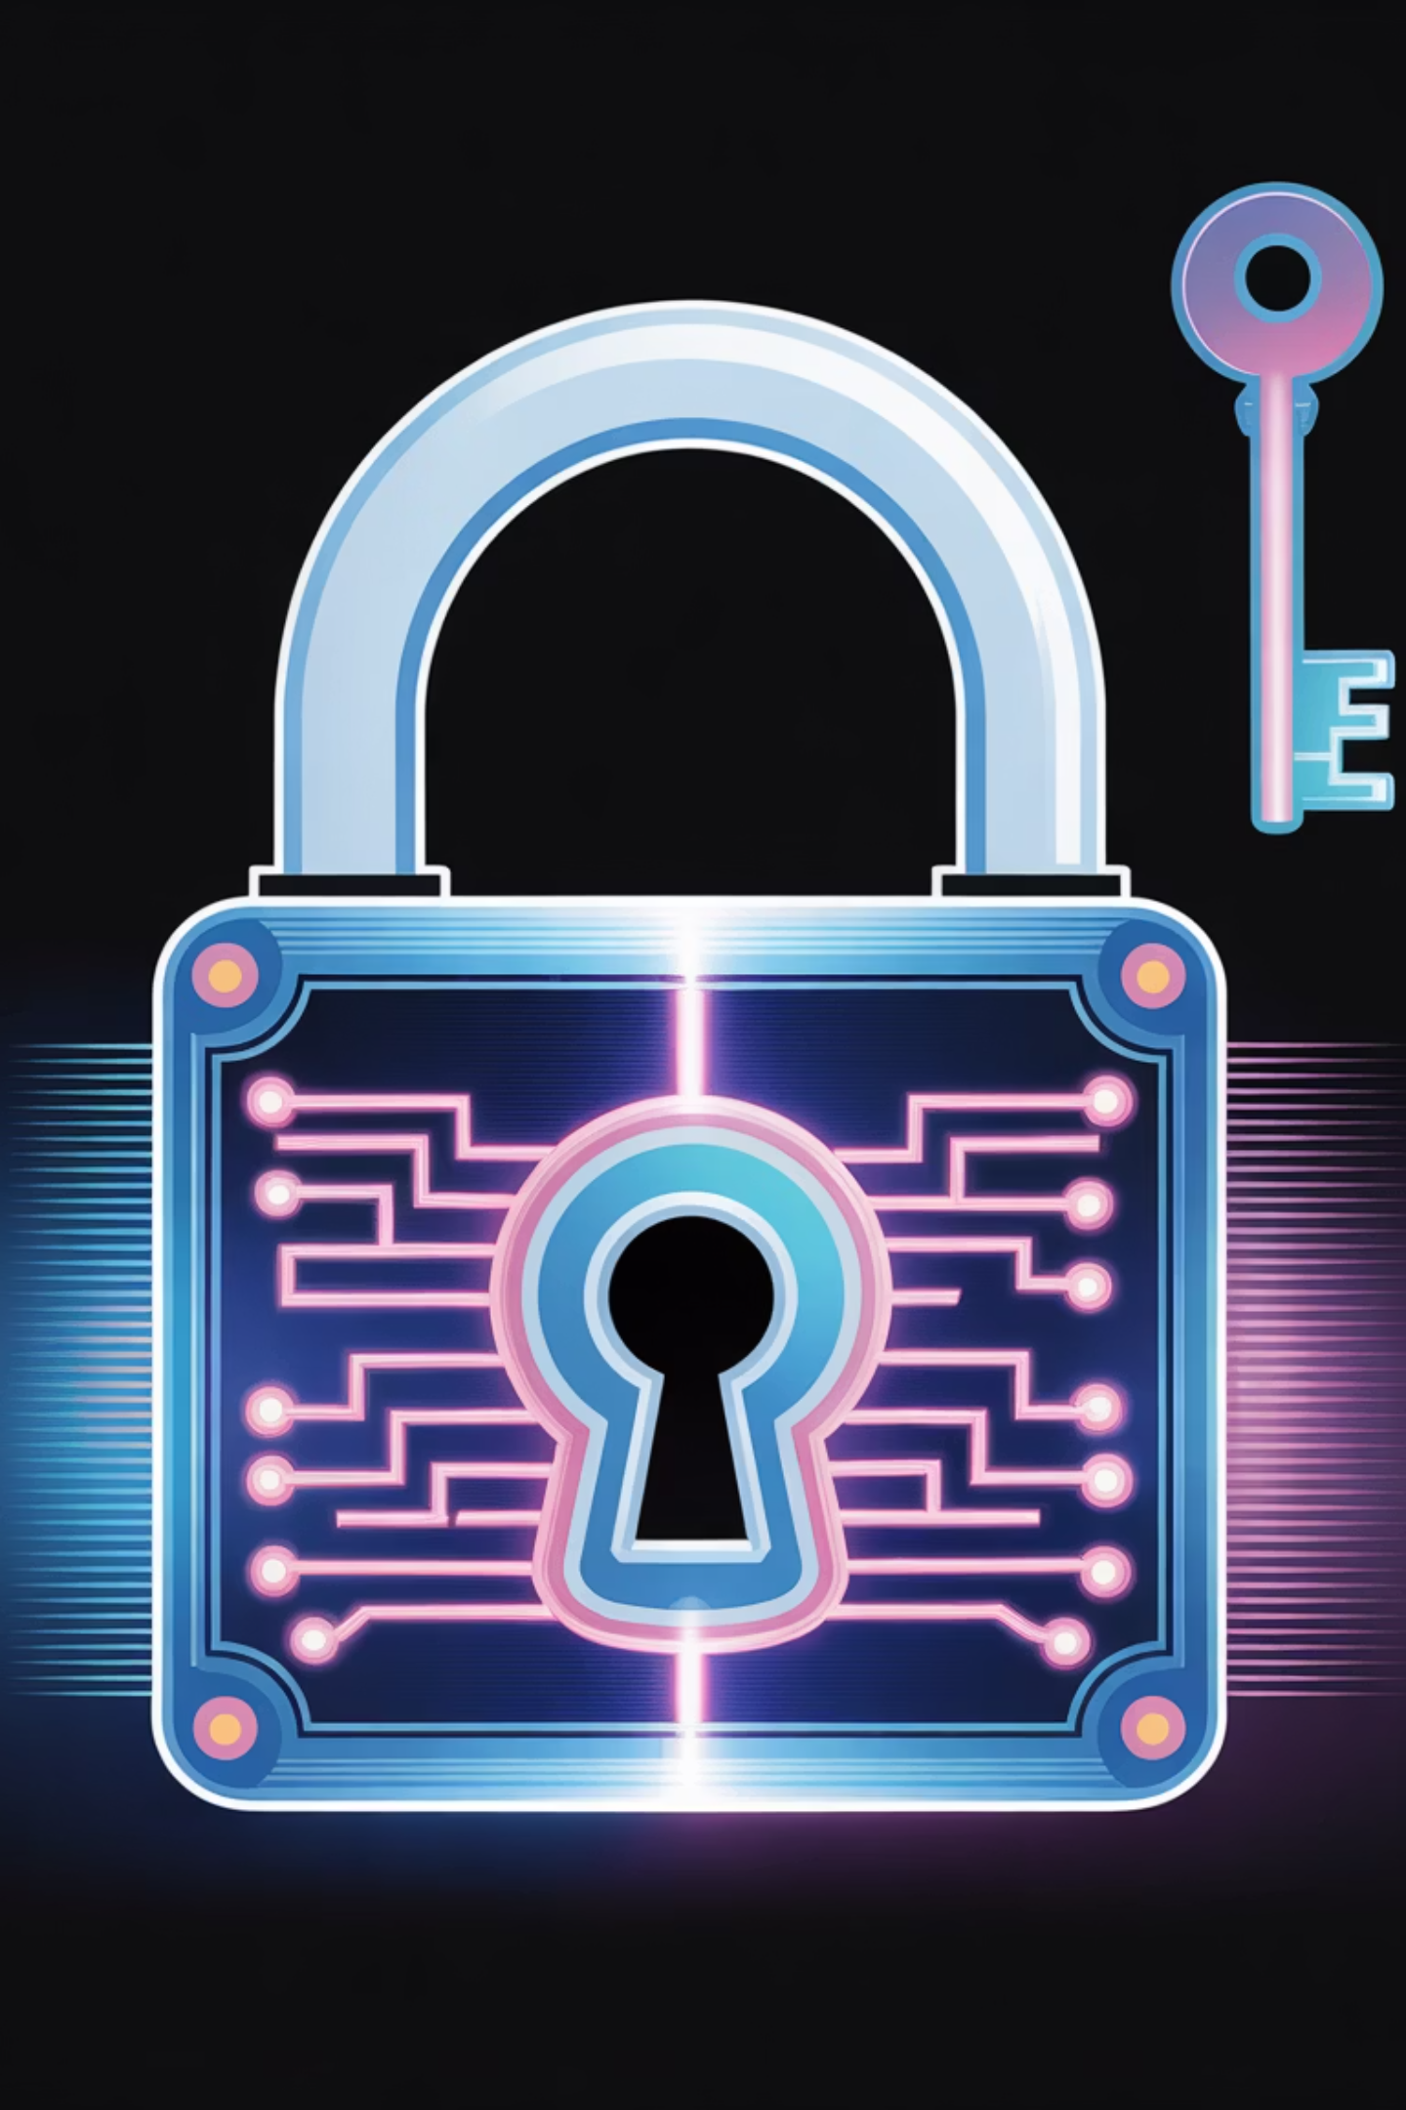
Stay Secure.
Conclusion: Empowering Users Against Fraud
PayGuard AI successfully addresses a critical vulnerability in the digital economy. The prototype demonstrates that AI can empower everyday users to detect scams instantly and stay secure in the digital payment era.
Built By
Contact & Connect
[Your Name]
Email: [your email ID]
College | CSE | B.Tech 2nd Year
LinkedIn / GitHub: [Optional Links]

